Slide 1
Trends and Seasonality
Using Multiple Regression with Time Series Data
Many time series data have a common tendency of growing over time, and therefore contain a time trend.
When making a causal (changes in X causing changes in Y) inference, we may falsely conclude that change in X caused change in Y.
It might be that both variables are trending in the same or opposite directions because of a third unobserved factor

Slide 2
It is crucial to recognize that any time series (values of a variable over time) may have any of the following four components. They are:
  Time series in general have a multiplicative functional form
Time Series
Trend Component
Seasonal Component
Cyclical Component
Irregular Component

Slide 3
Trend Component
Long-run increase or decrease over time (overall upward or downward movement)
Data taken over a long period of time
Trend can be upward or downward
Trend can be linear or nonlinear such as exponential growth
Sales
Upward trend
Time

Slide 4
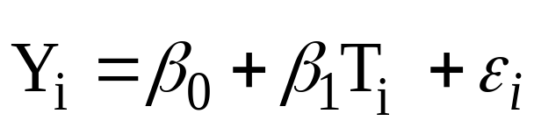
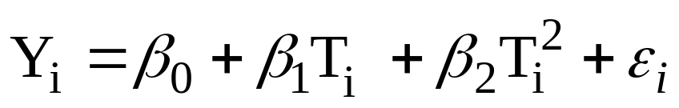
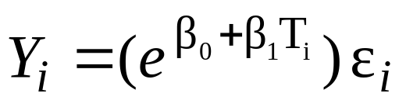
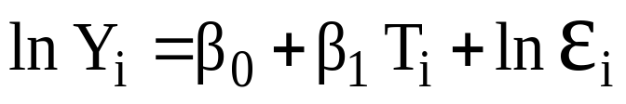
How do we capture the trend component?
  A linear trend
      Where Y_{i} is the values of variable Y and T is time=1, 2, 3, . . .,
  A nonlinear trend (quadratic)
  An Exponential Trend (growth)
  Transform this to a linear trend by:

Slide 5
Seasonal Component
  Short-term regular wave-like patterns
  Observed within 1 year
  Often monthly or quarterly
Sales
Summer
Winter
Summer
Winter
Spring
Fall
Spring
Fall
Time (Quarterly)

Slide 6
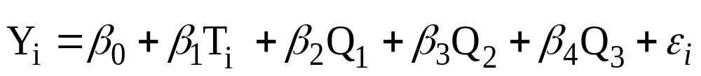
How do we capture the trend and Seasonality components? (note that the graph has both trend and seasonality)
    A linear trend
    An Exponential Model (growth) can be transformed to
      Remember how to interpret the coefficients
Where Q is Indicator for the quarter=1, 2, and 3

Slide 7
Cyclical Component
  Long-term wave-like patterns
  Regularly occur but may vary in length
  Often measured peak to peak or trough to trough
1 Cycle
Sales
Year

Slide 8
How do we capture the Cyclicality?
  With inclusion of explanatory variables both quantitative and/or indicators (dummy variables)
Irregular Component
  Unpredictable, random, “residual” fluctuations
  Due to random variations of
    Nature
    Accidents or unusual events
  “Noise” in the time series

Slide 9
Example:
Does housing supply in the U.S. respond to housing prices?
  Data Annual: from 1947-1988
  We assume supply equation for housing stock is a function of housing prices. We also assume that increase in population shifts the supply outward.
  To capture the effect of population, we regress natural log of real per capita housing investment in thousands of dollar (by developers) against natural log of housing price index (1982=1 or 100 percent). The estimated coefficient is price elasticity of supply.
  See the hand out

Slide 10
Example 2(Trend and involves possible cyclical data series):
  Did the U.S. fertility rate ( the number of children born to women of child-bearing age, 15-44) decline in the 20 century?
  Did World War II affect the fertility rate (1941-1945)?
  What was the effect of the birth control pill becoming available for contraception (from 1963 on)?
  Does average real dollar value (inflation adjusted) of the personal tax exemption affect the fertility rate?
  See the hand out

Slide 11
Example 3 (possible trend and seasonality)
  Have the number of automobile accidents increased or declined overtime? (evidence from California)
  Is the number of automobile accidents seasonal?
  Did the passage of 65 mph in may 1987 affect the number of accidents? (effect of a public policy)
  What is the effect(s) of seatbelt laws that were Implemented in Jan. 1986? (another public policy issue)
  Is the state of the economy (as measured by unemployment rate) a factor affecting the number of accidents?
  Are there more or less accidents on the weekend compared to the weekdays?
  What are the impacts of above factors on the fatality resulting from an accident?

